Slide 1
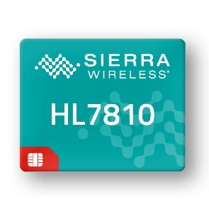
HL7810 Specifications
Commercially Available
Cellular
LTE Multi Mode LTE Cat-M1 and NB2
Bands @23dBm: 1-5, 8,12,13,18-20, 25, 26, 28, 66, 85
Cat-M1 Peak Data Rates: DL: 590/ UL:1100 kbps (Rel14)
Cat-NB2 Peak Data Rates: DL:127/ UL:158 kbps
Single RX/TX antenna port
Key Features
Compatible with HL Series from 2G/3G/4G (Cat-4, Cat-1)
Extremely low power consumption with PSM support
Extremely low power consumption with eDRX support
Extended coverage mode support
Embedded TCP/IP stack with TCP, UDP, FTP, HTTP
Embedded security with HTTPS, Secure socket, Secure Boot
Embedded SIM (Ready-to-Connect) SKU Option
Extended power supply range
Integrated GNSS – GPS/GLONASS, AGNSS
Development tools: HL Series development kit, FW download tool
Secure boot prevents unauthorized code on the target
Free FOTA through AirVantage® FOTA Edition
LPWA
Hardware Specs
Dimensions: 15 x 18 x 2.4 mm [LGA]
Chipset: SONY ALT1250
Host Interfaces
8-wire UART
USB
Peripheral Interfaces
12x GPIO
External SIM
32kHz and 26MHz clock output
Temperature Ranges
-30C to +70C (operating class A)
-40C to +85C (operating class B)
Input voltage: 3.2V to 4.35V
Approvals
FCC, IC, PTCRB, GCF, JRF/JPA, KC, NCC, RCM, CE

Slide 2
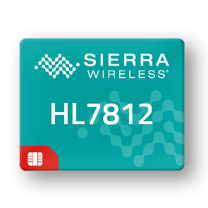
HL7812 Specifications
Commercially Available
Cellular
LTE Multi Mode LTE Cat-M1 and NB2
Bands @23dBm: 1-5, 8,12,13,18-20, 25, 26, 28, 66, 85
Cat-M1 Peak Data Rates: DL: 590/ UL:1100 kbps (Rel14)
Cat-NB2 Peak Data Rates: DL:127/ UL:158 kbps
Quad-band GSM, GPRS
Single RX/TX antenna port
Key Features
Compatible with HL Series from 2G/3G/4G (Cat-4, Cat-1)
Extremely low power consumption with PSM support
Extremely low power consumption with eDRX support
Extended coverage mode support
Embedded TCP/IP stack with TCP, UDP, FTP, HTTP
Embedded security with HTTPS, Secure socket, Secure Boot
Embedded SIM (Ready-to-Connect) SKU Option
Extended power supply range
Integrated GNSS – GPS/GLONASS, AGNSS
Development tools: HL Series development kit, FW download tool
Secure boot prevents unauthorized code on the target
Free FOTA through AirVantage® FOTA Edition
2G
LPWA
Hardware Specs
Dimensions: 15 x 18 x 2.4 mm [LGA]
Chipset: SONY ALT1250
Host Interfaces
8-wire UART
USB
Peripheral Interfaces
12x GPIO
External SIM
32kHz and 26MHz clock output
Temperature Ranges
-30C to +70C (operating class A)
-40C to +85C (operating class B)
Input voltage: 3.2V to 4.35V
Approvals
FCC, IC, PTCRB, GCF, RCM, CE, JRF/JPA

